Slide 2
Session Recording "START"

Slide 3


Data Entity – 360° View
MVP

Slide 4
Agenda
Data Entities
Data Management framework
Manage configuration data
Create custom Data Entities – DEMO
General Journal import - DEMO
Tips and Tricks/New Features

Slide 5
Data Entities

Slide 6
Data Entities Overview
Table
Table
Table
More than 3000+ Standard Data Entities
Data Entity

Slide 7
Data Entities: Concept
Customer
(CustTable)
Electronic address
(LogisticsElectronicAddress)
Customer Entity
Account number
Customer group
Bank account
Party number
Name
Primary postal address
Primary email address
Primary fax number
Party
(DirPartyTable)
Location
(LogisticsLocation)
Postal address
(LogisticsPostalAddress)
Party-Location relationship
(DirPartyLocation)
Location roles
(LogisticsLocationRole)
Party-Location role
Relationship
(DirPartyLocationRole)
Conceptual abstraction and encapsulation of underlying table schemas

Slide 8
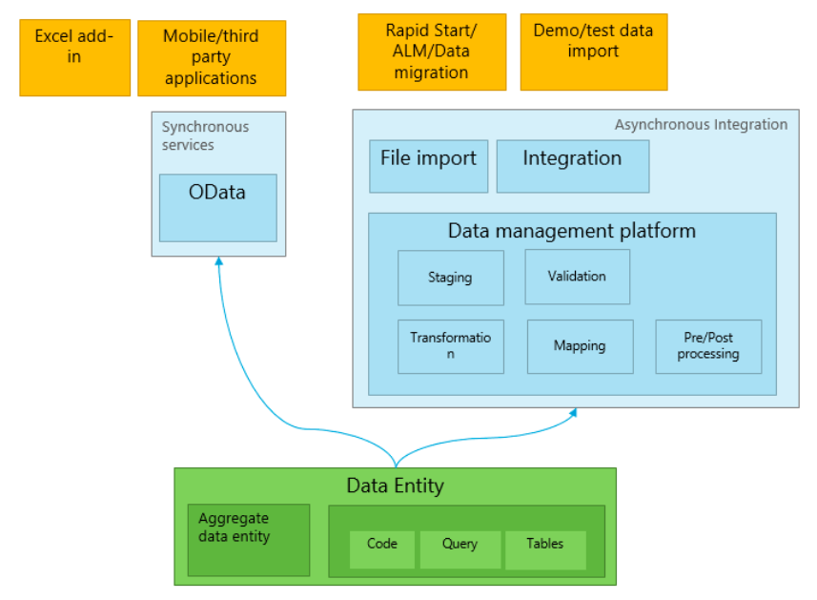
Data Entities Usage

Slide 9
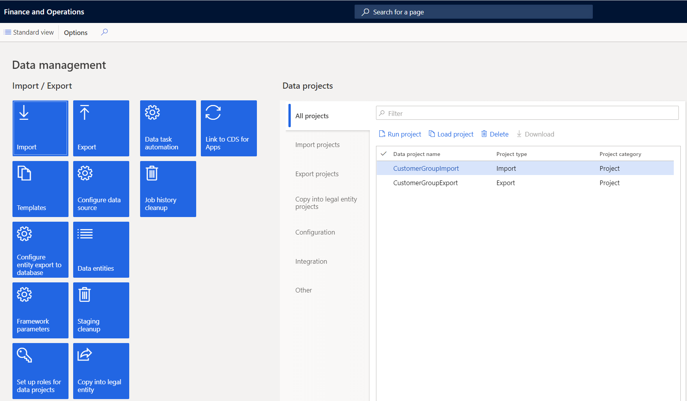
Data Management Platform

Slide 10
Data Management Scenarios
Initial configuration of new implementation
Data migration from legacy systems
Copy configuration – same environment
Copy data between environments
Integrations with other systems

Slide 11
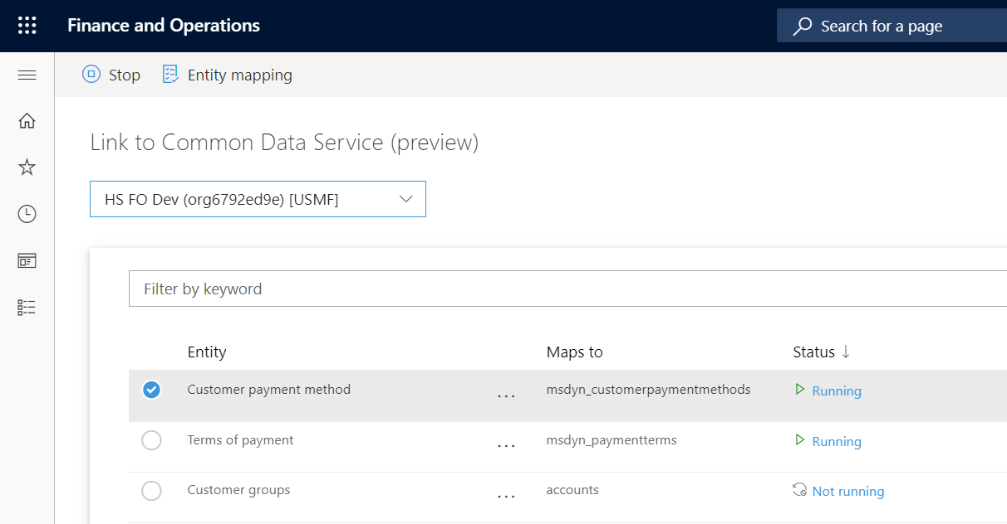

Dual Write - CDS

Slide 12
Manage Configuration Data

Slide 13
Manage Configuration Data
Between instances
Same Instance

Slide 14
Data Templates
OOTB Module-wise templates
Customize templates
Use Open in Excel feature
Sequence Entities
Discover dependencies
Export/Import template
Create Data projects
Data Entity
Data Project
Template

Slide 15
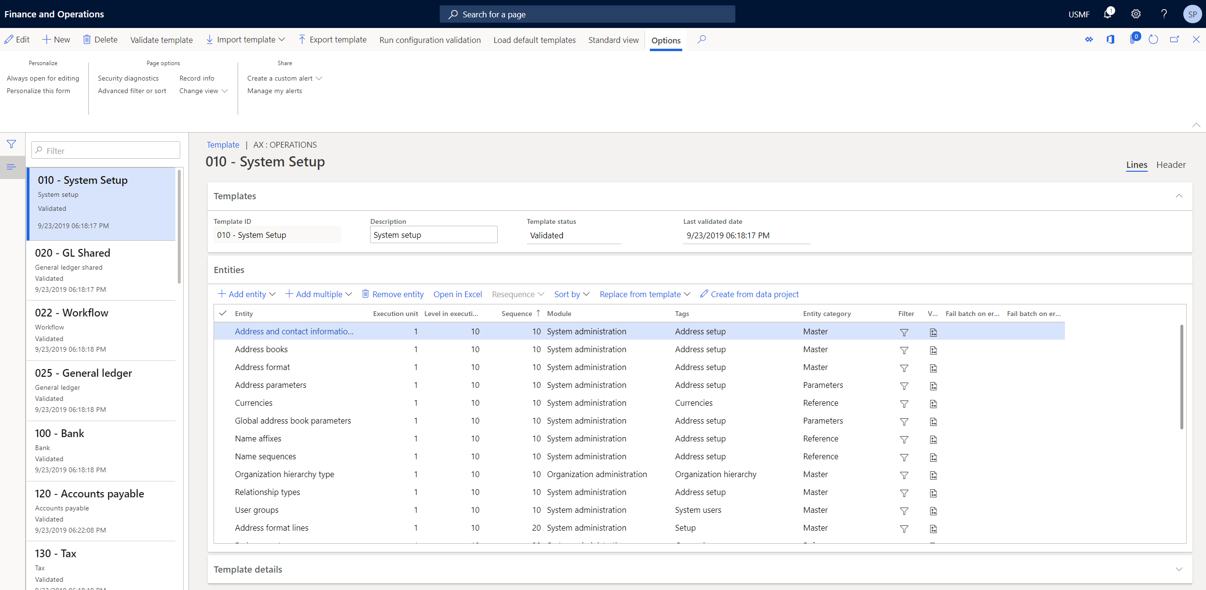
Data Templates

Slide 16
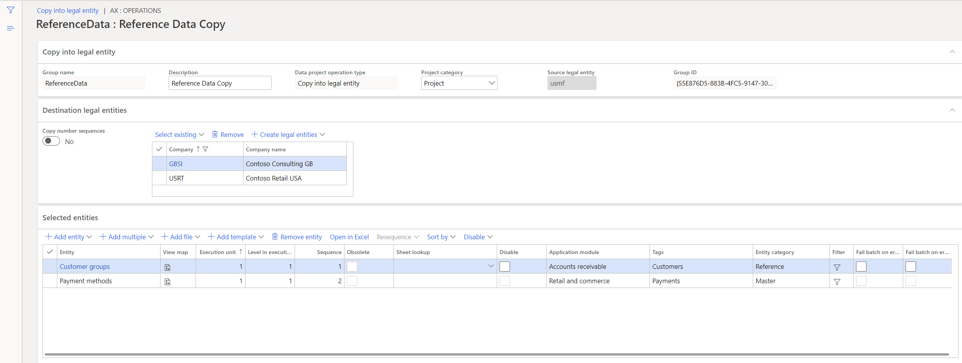
Copy into legal entity

Slide 17
Data Packages

Slide 18
Data Packages
File Type – Zip format
Create import/export file templates
Multiple entities
Export/Import Data
Data Entity Template
Data
Project
File with/out data
Data Package

Slide 19
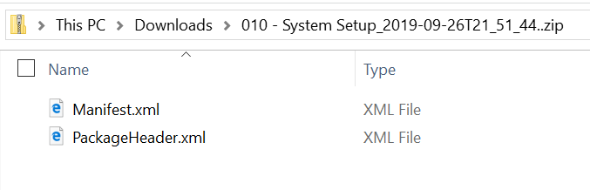
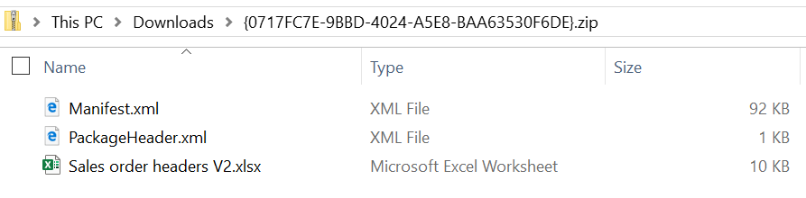
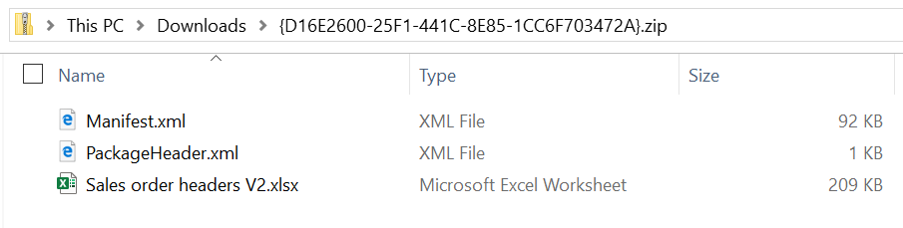
Data Templates vs Data Packages
Data Template
Data Package (Without data)
Data Package (With data)

Slide 20
Custom Entity - Scenario

Slide 21
Worker Import using standard entities
Worker
Employment Entity
Positions
Position Duration
Position worker assignments
Position details
Jobs

Slide 22
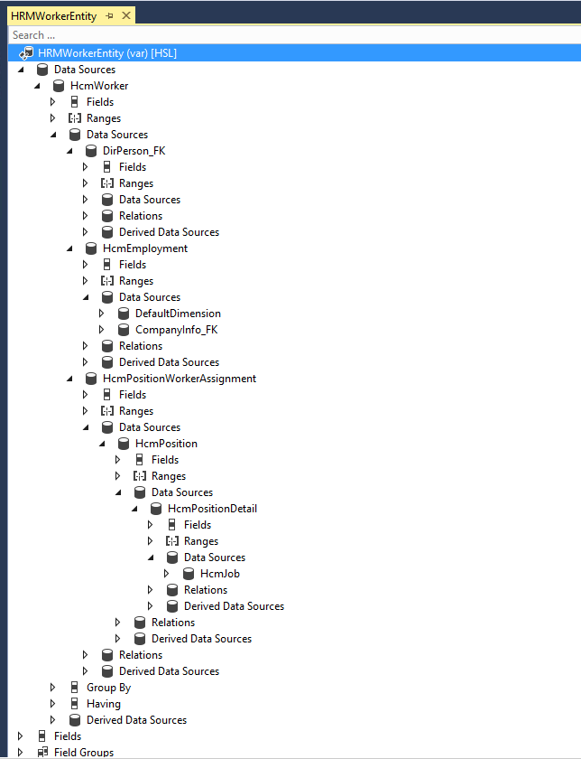
Import using custom entity

Slide 23
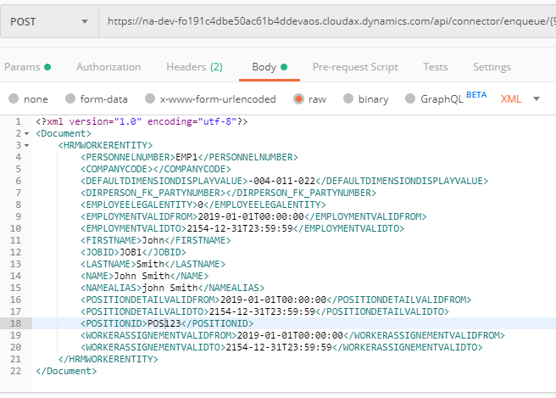
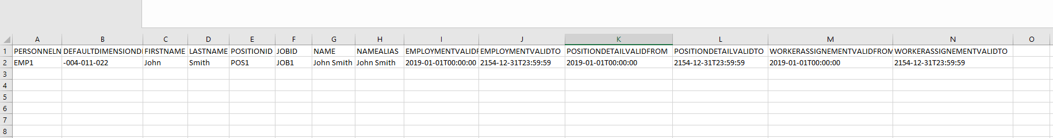
Custom entity-File format
XML
Excel

Slide 24
Demo - Custom Entity

Slide 25
General Journal Import - Scenario

Slide 26
General Journal Import
Journal Batch Number
Number sequence – Automatic
Data Mapping – No auto-generation
Field data – Leave blank/Sequence
Voucher
Set Based processing - No
No voucher in file
Set Based processing – Yes
Voucher from file
Voucher from System
Number allocation at posting

Slide 27
Demo – General Journal Import

Slide 28
Tips and Tricks New Features

Slide 29
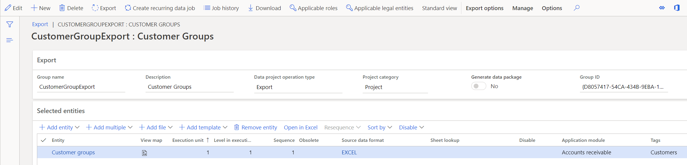
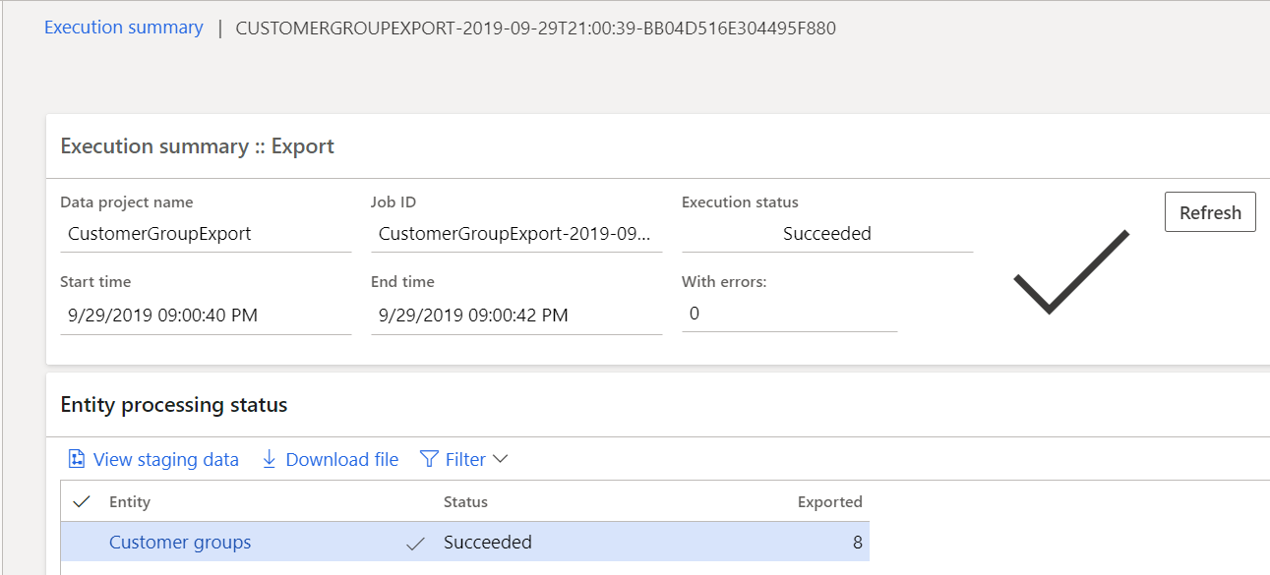
Template File / Data Export

Slide 30
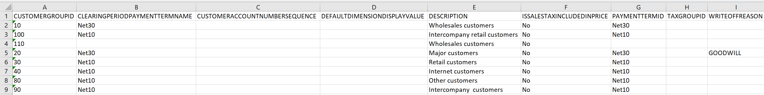
Template File / Data Import
Customer Group Import Template

Slide 31
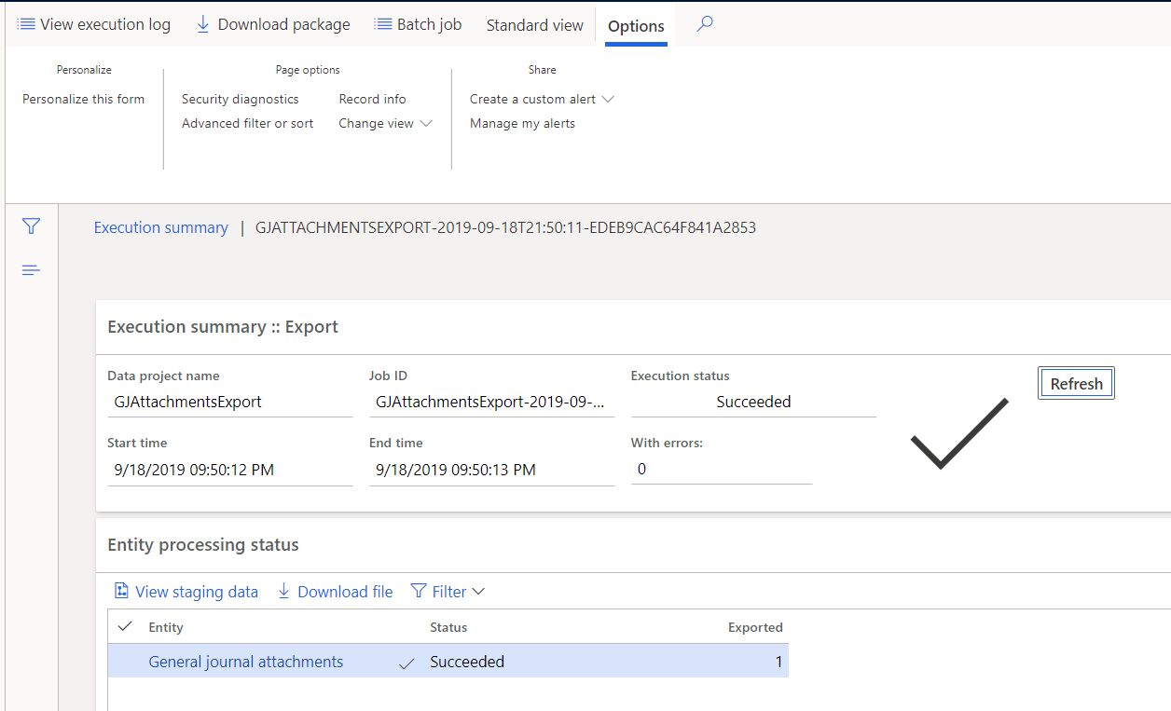
General Journal Attachments – Download file
Create Export Project
Run Project
Execution Summary
Download file

Slide 32
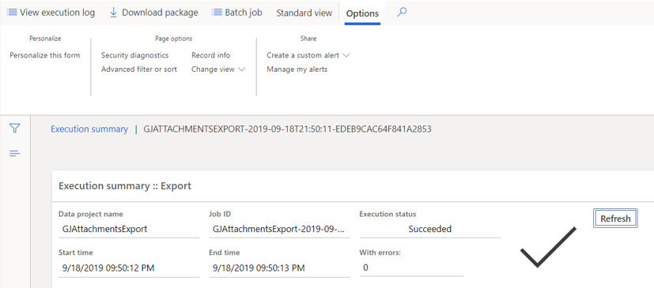
General Journal Attachments – Download Package
Download File
Download Package

Slide 33
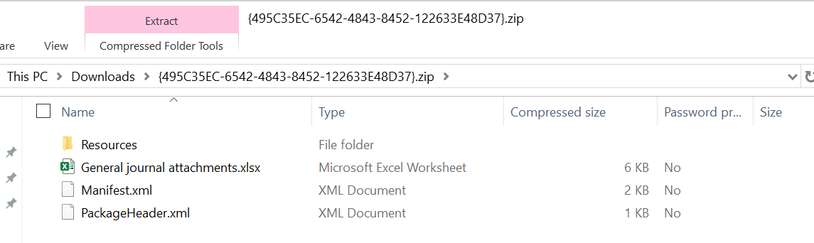
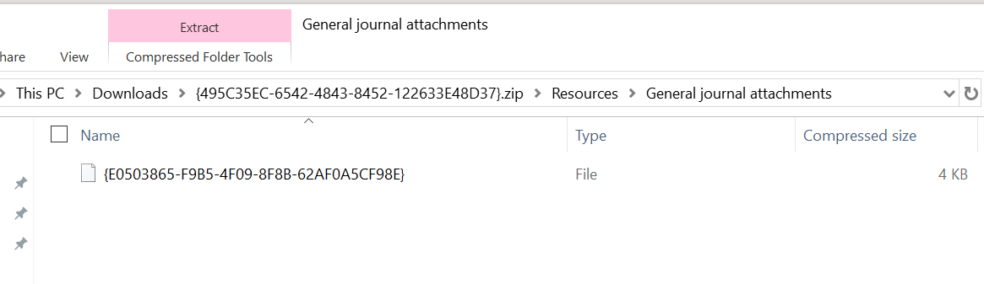
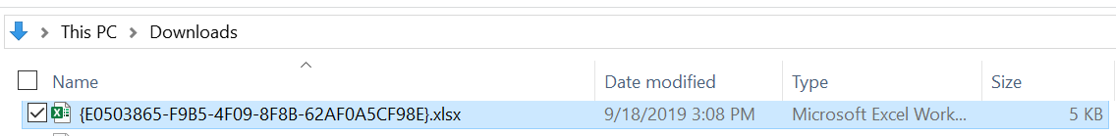
General Journal Attachments – Download Package
Package Contents
Resources Directory
Add file extension

Slide 34
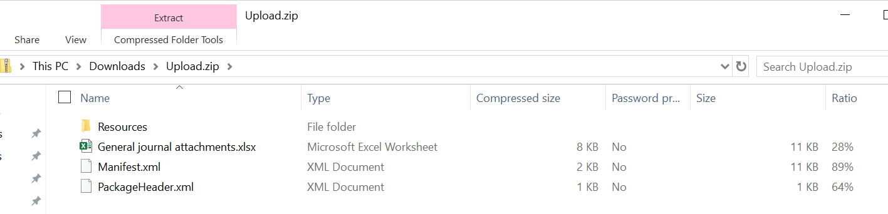
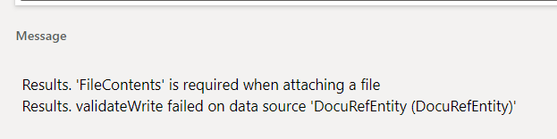
General Journal Attachments – Import Tricks
Zip Contents
No Nested folders
File Contents Error
File type issue

Slide 35
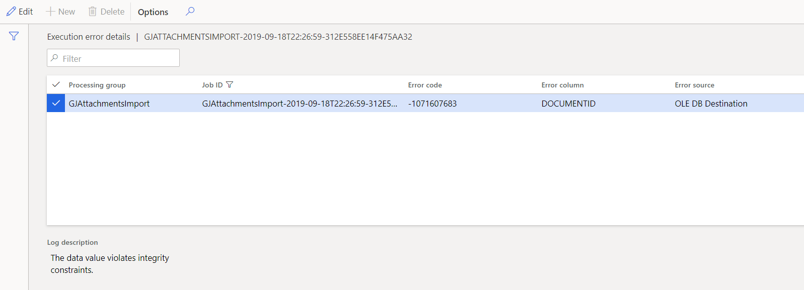
General Journal Attachments – Import Tricks
Data value integrity
constraints

Slide 36
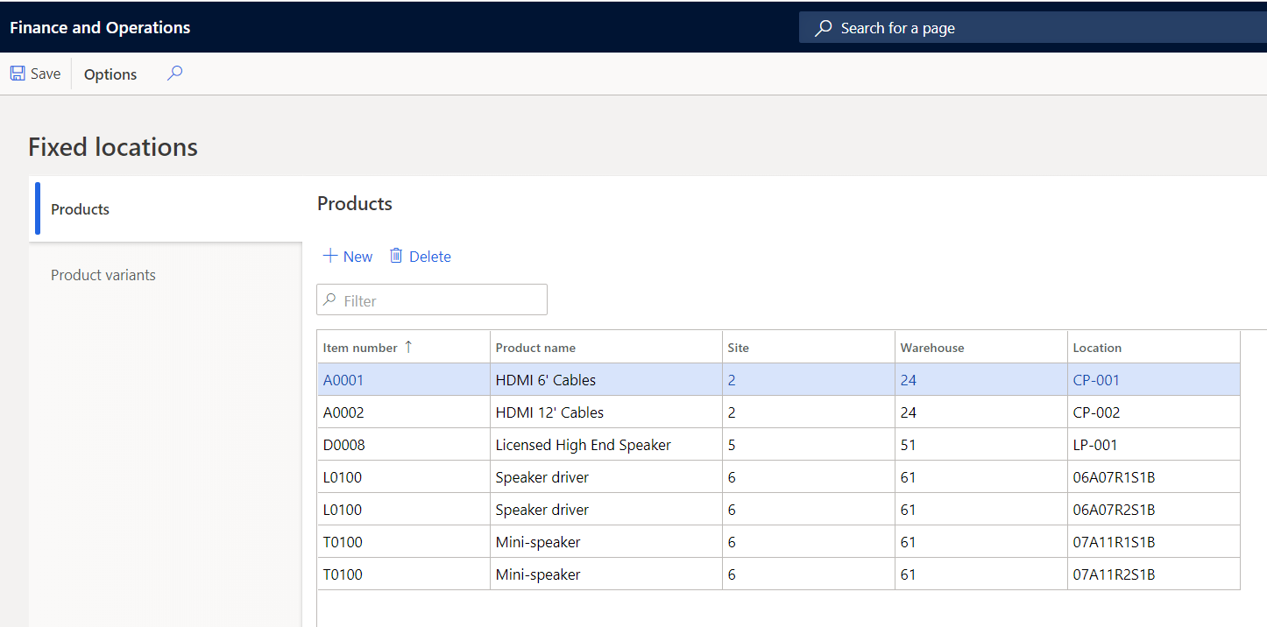
Data Deletion / Truncate

Slide 37
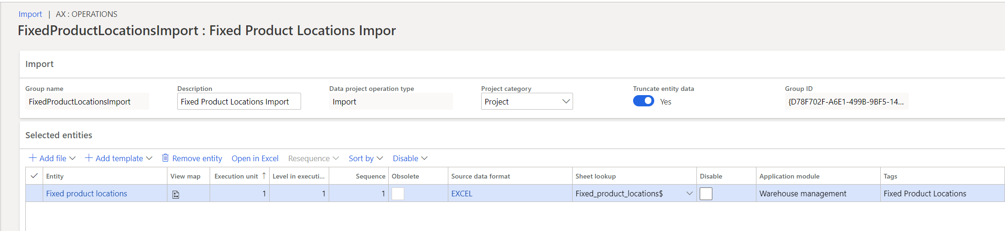
Data Deletion / Truncate
Utilize Data entity – Truncate entity feature
Analyze before deletion
Backup data prior to deletion

Slide 38
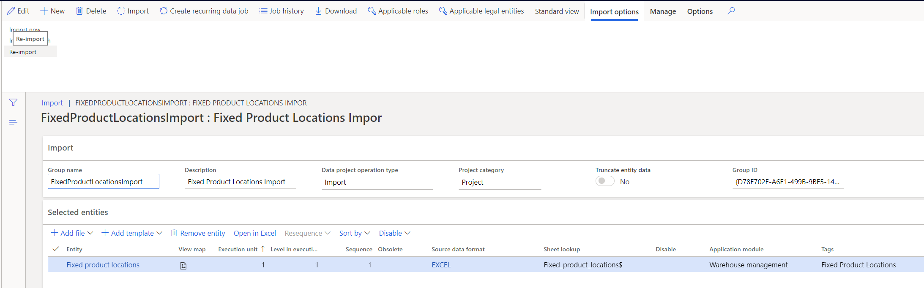
Re-import file with changes

Slide 39
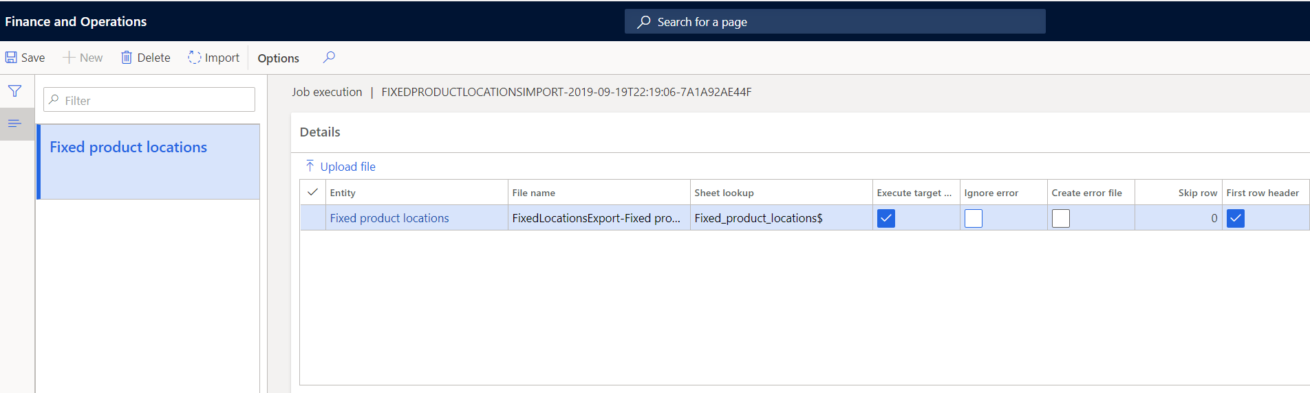
Re-import file with changes
Upload file button
Browse file
Upload file
Run process

Slide 40
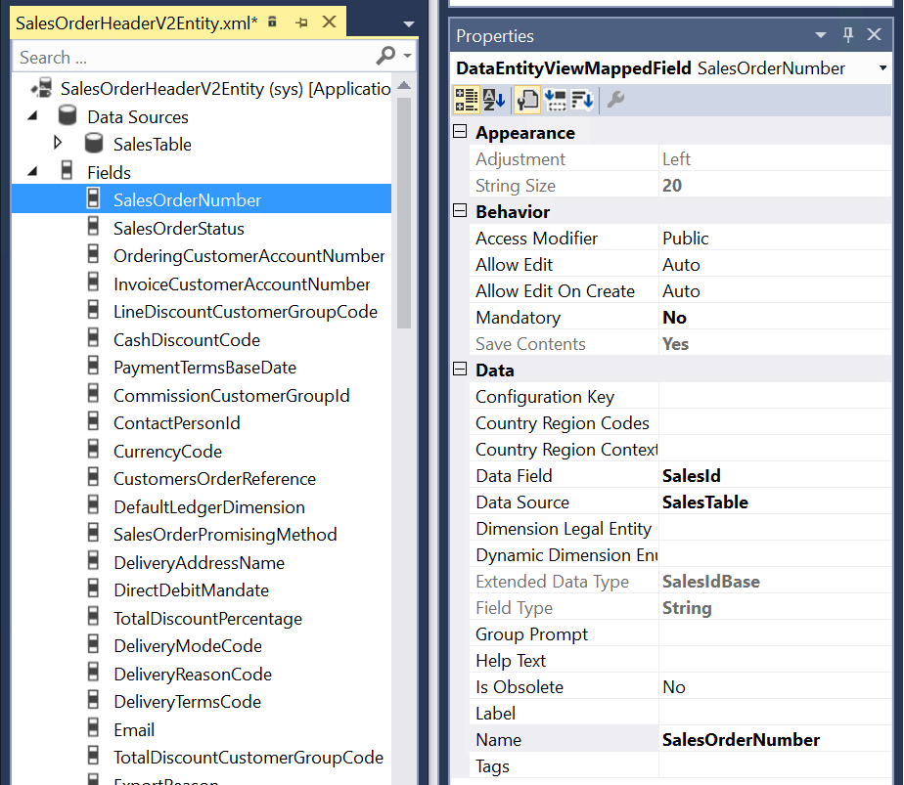
Data Entity – Mapped Fields
Data directly from D365
No data manipulation

Slide 41
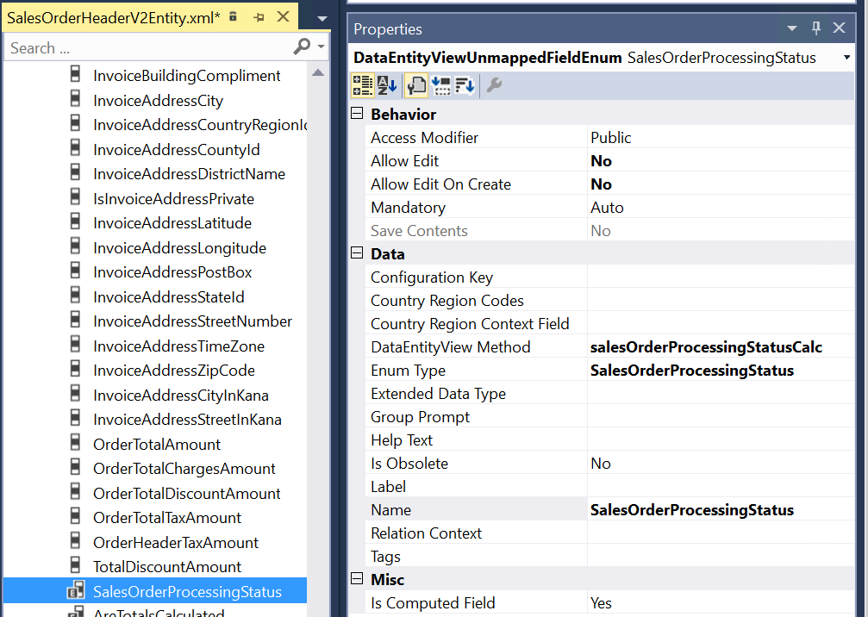
Data Entity – Unmapped Fields (Computed)
Computed Columns – Value from SQL
Write – Parse and set mapped fields
Mostly for reads

Slide 42
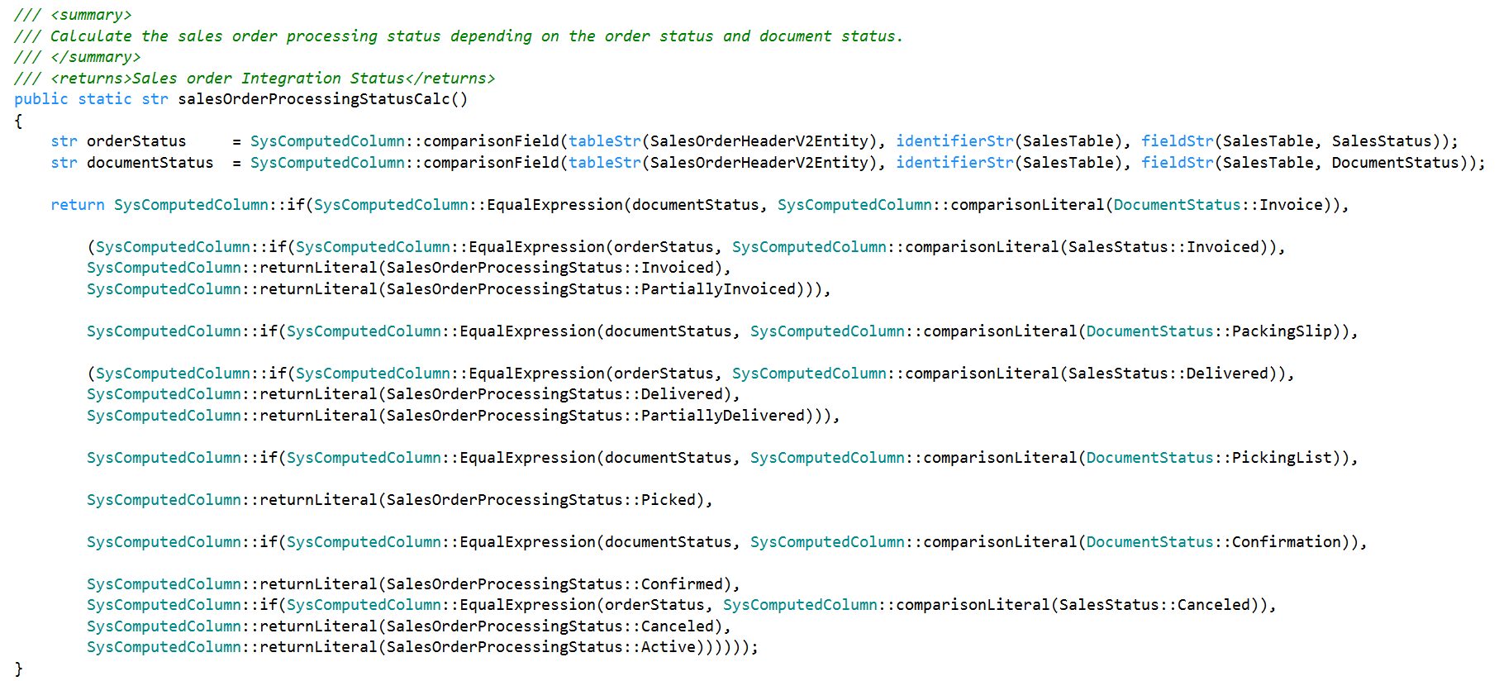
Data Entity – Computed columns
SalesTable
SalesStatus
DocumentStatus

Slide 43
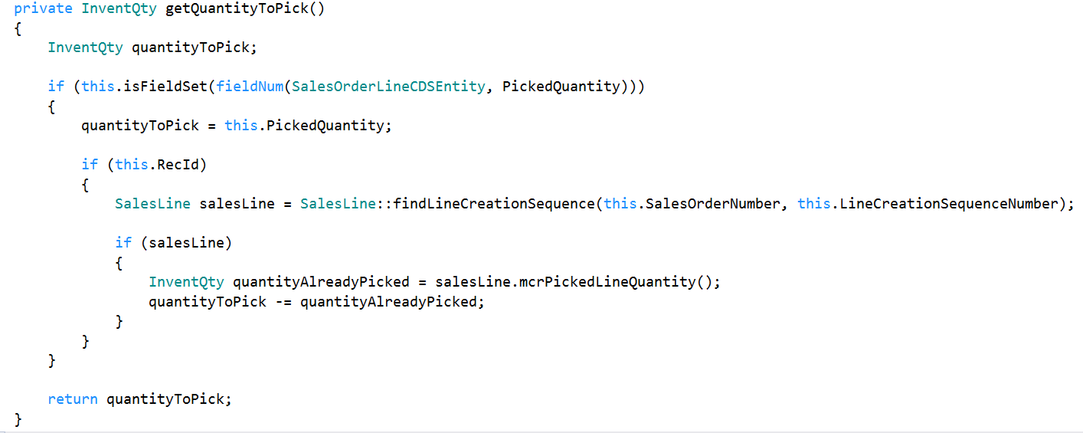
Data Entity – Unmapped Fields (Virtual columns)
Controlled via X++ code
Read/Write through custom code
E.g. SalesOrderLineCDSEntity - PickedQuantity field
Computed line by line

Slide 44
Entity list refresh
New environment provisioning
Code Package Deployment
Configuration Keys
Development of new entity

Slide 45
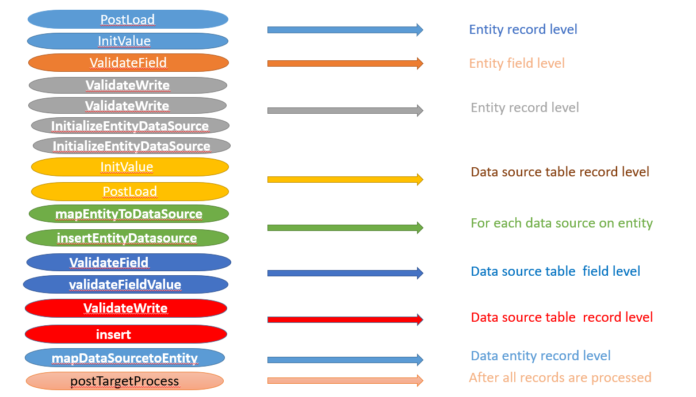
Data entity Import method execution sequence

Slide 46
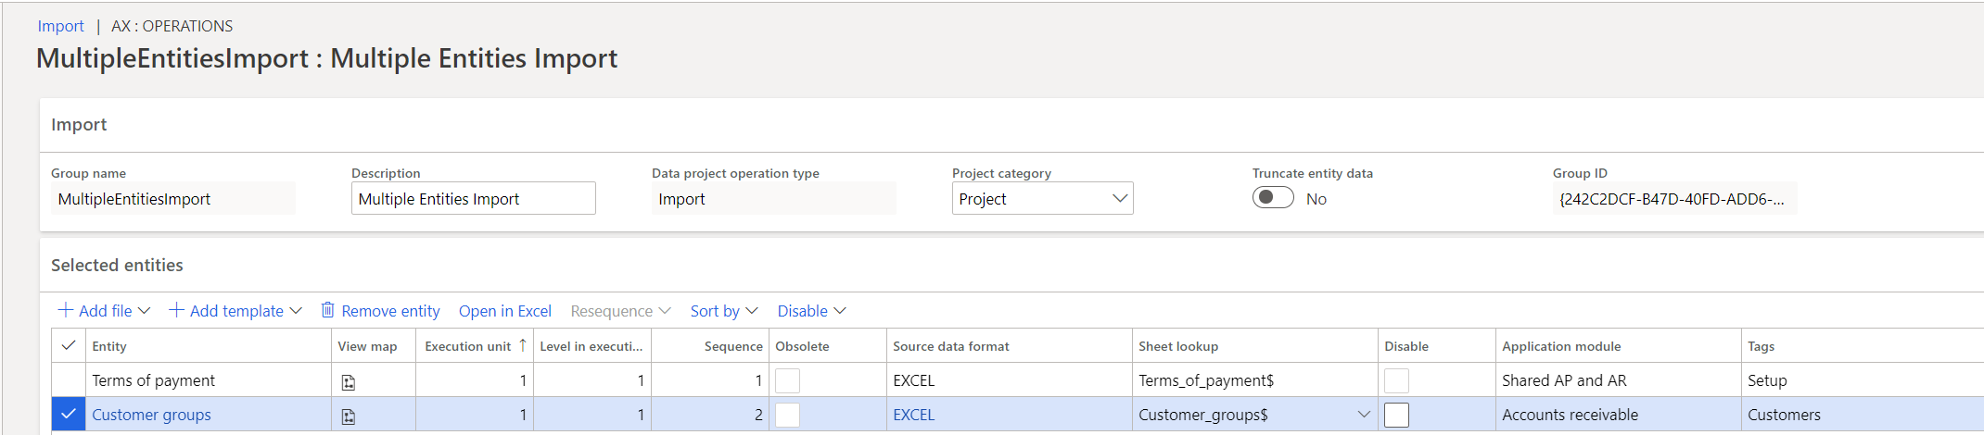
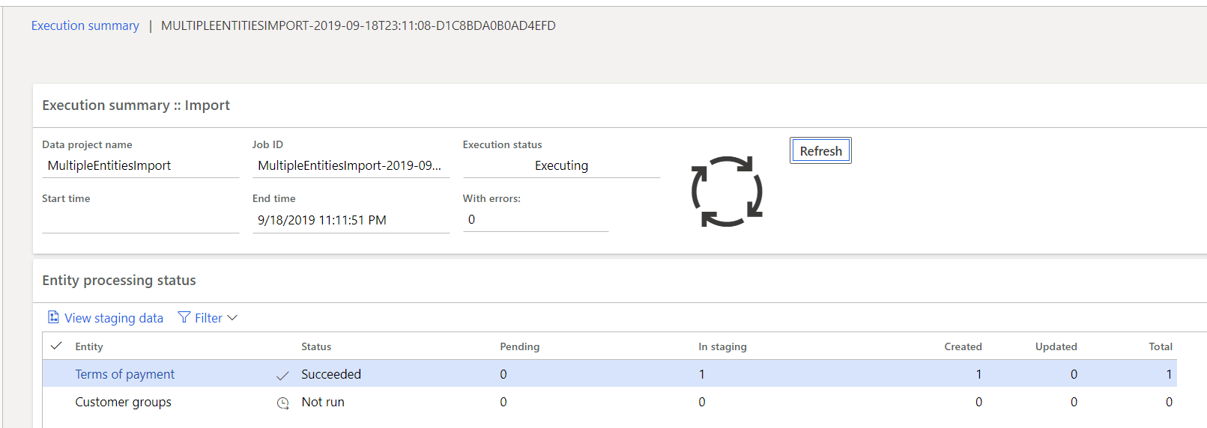
Data Entity – Sequential Processing

Slide 47
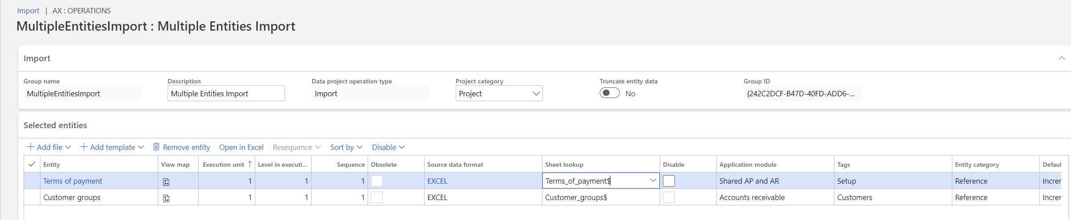
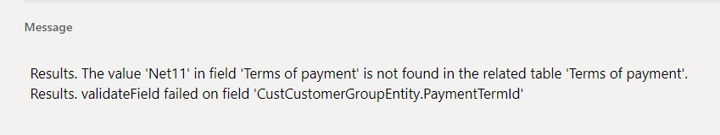
Data Entity – Parallel Processing
Sequence - same
Consider dependencies

Slide 48
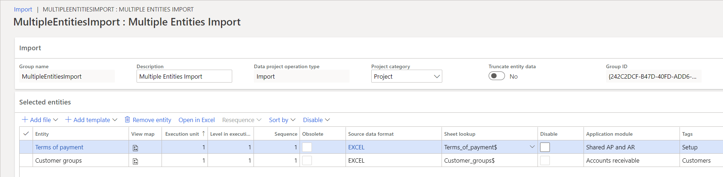
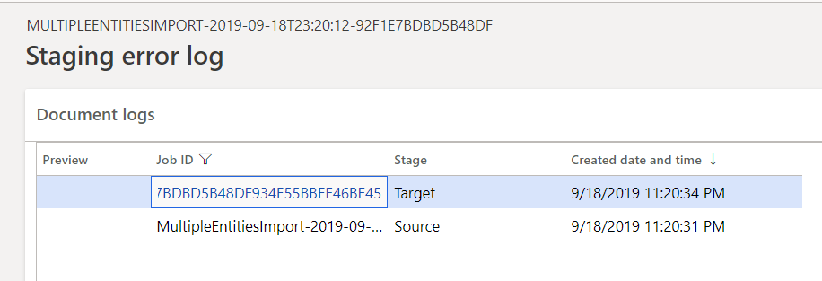
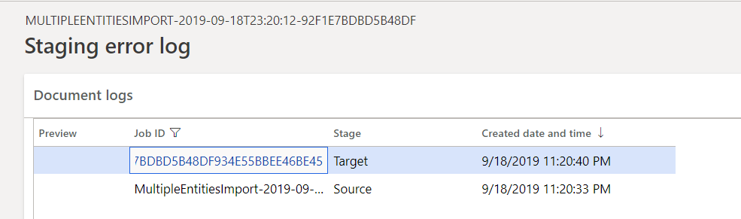
Data Entity – Parallel Processing
Sequence – same
Dependencies - None

Slide 49
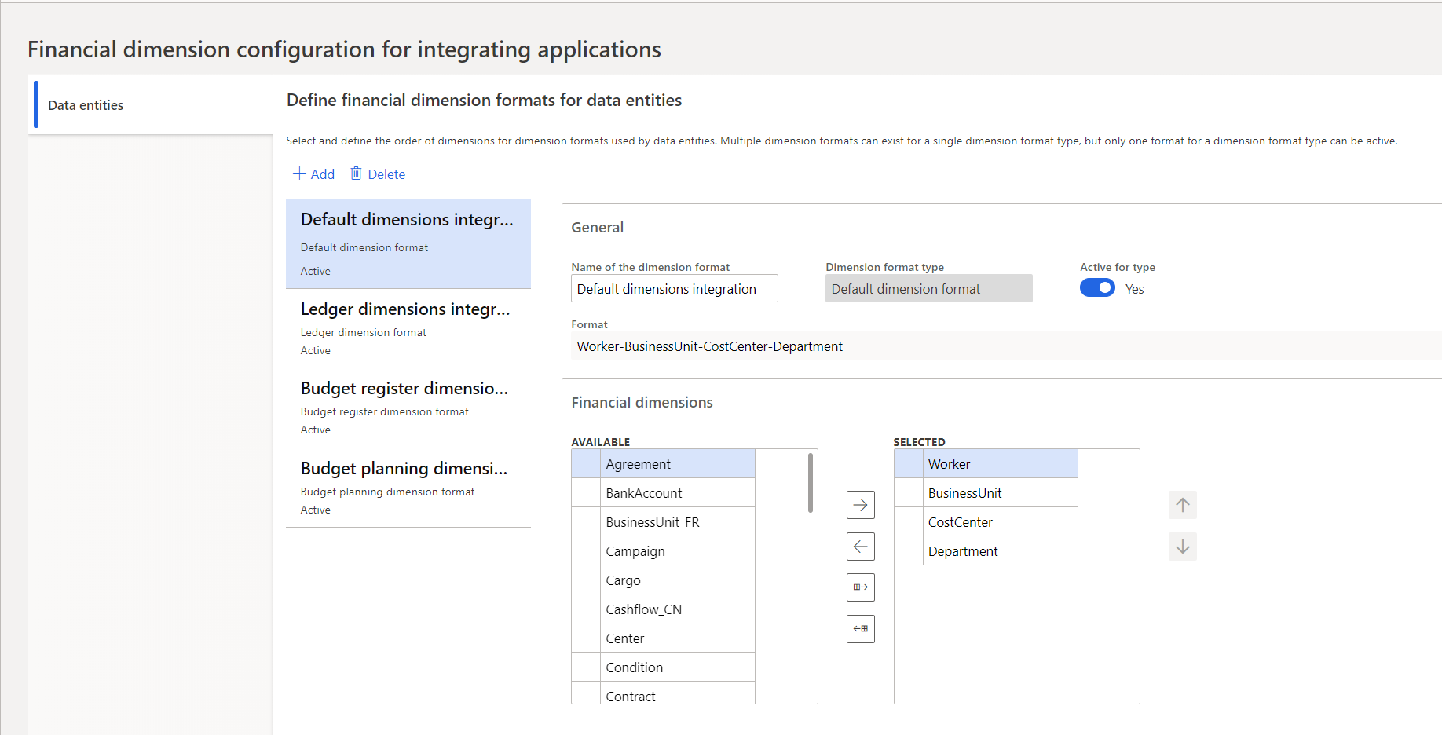
Financial Dimension – Import format/Sequence

Slide 50
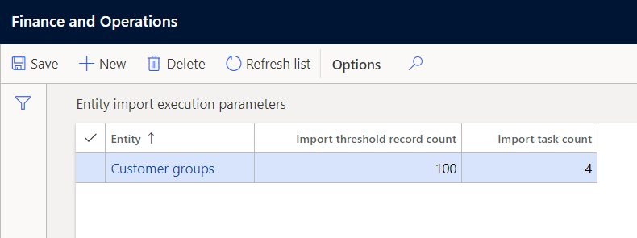
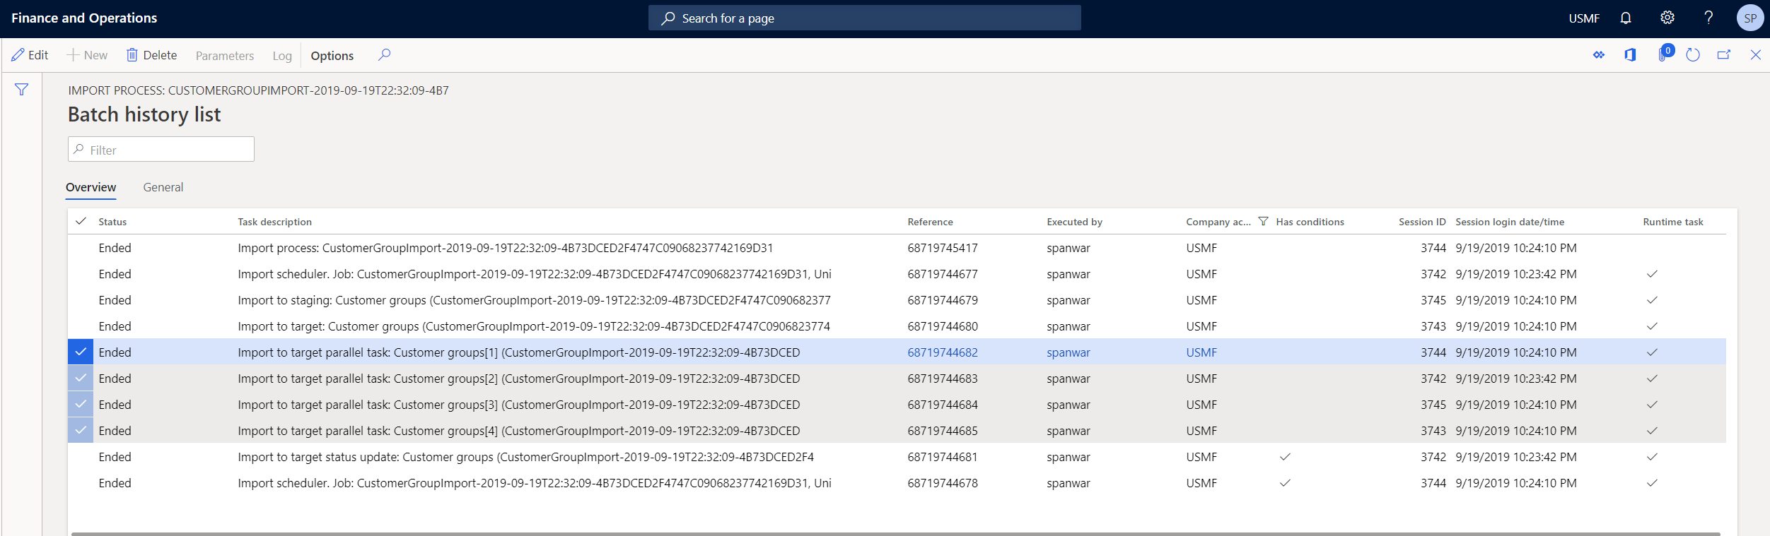
Multi-threading during Data import
Framework parameters
Entity settings
Entity execution parameters

Slide 51
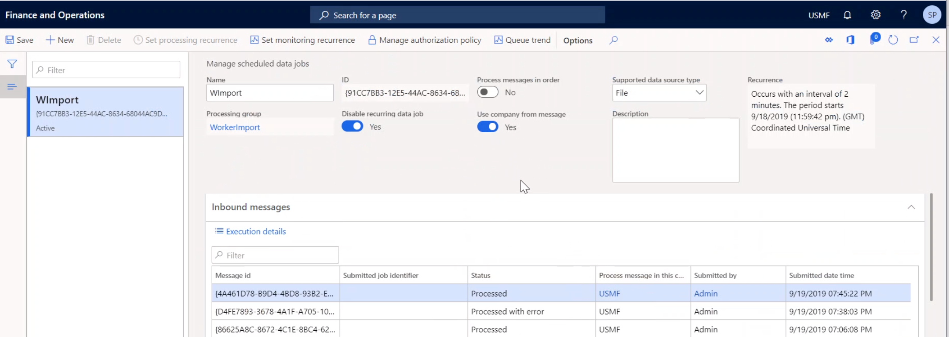
Legal Entity and Sequencing

Slide 52
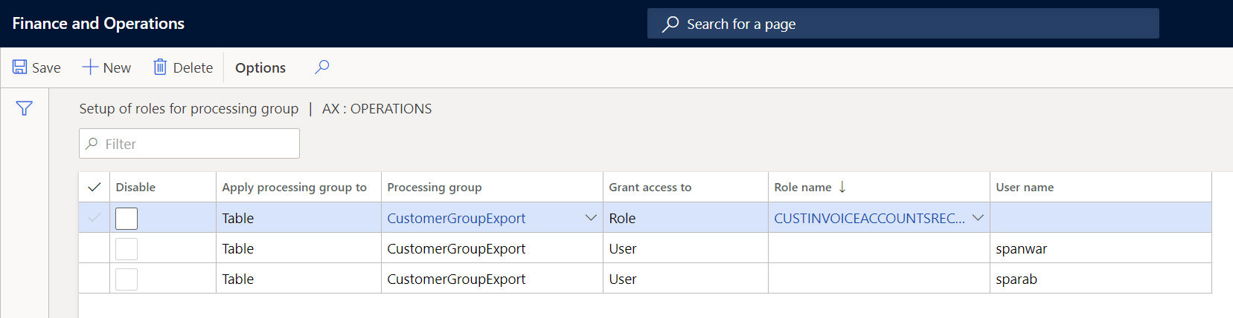
Data Entities and Security
Standard Roles
Data Management Operations user
Data Management migration user
Data Management Administrator
Sensitive data
Utilize Table Protection Framework (TPF)
Credit Card
Social Security

Slide 53
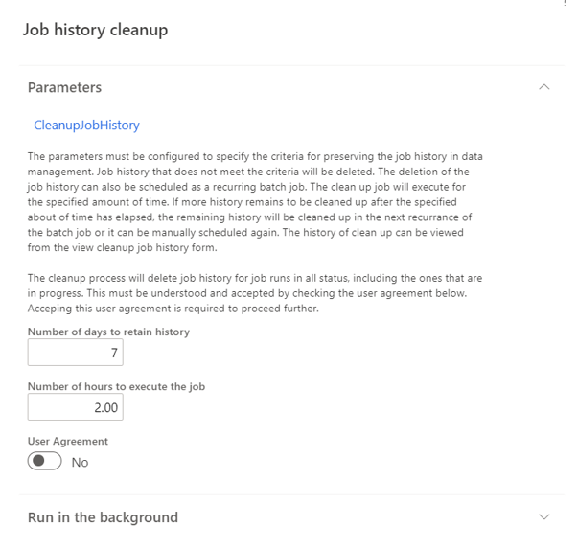
Job history cleanup
Enable through Feature management
Periodic cleanup of execution history
Scheduling parameters
Number of days to retain history
Number of hours to execute the job
Recurring batch

Slide 54
Session Recording “STOP"

Slide 55
Questions?

Slide 56
Thank you for attending!
Please complete your survey

Slide 57


